Slide 1
Fitting Straight Line
https://atozmath.com/example/CONM/LeastSquare.aspx?he=e&q=1

Slide 2
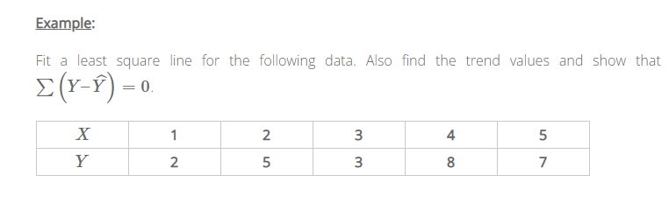
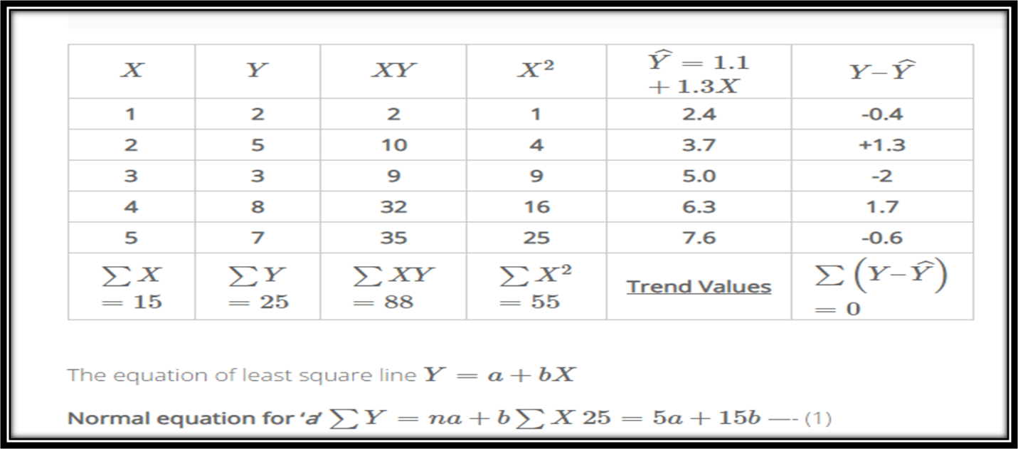

Slide 3
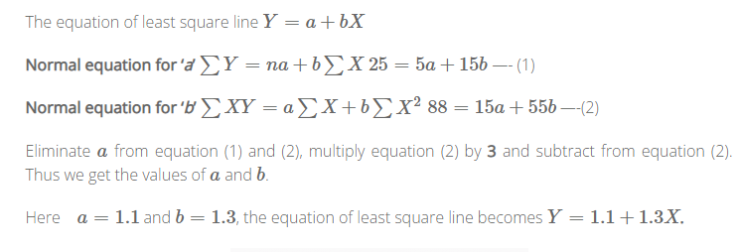

Slide 4
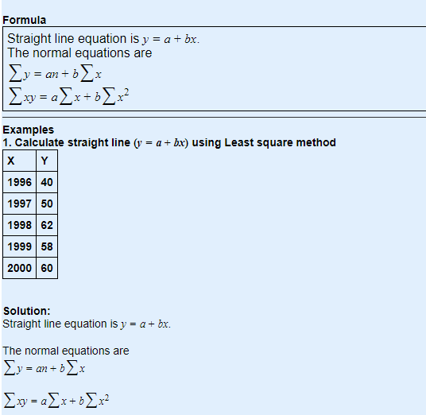

Slide 5
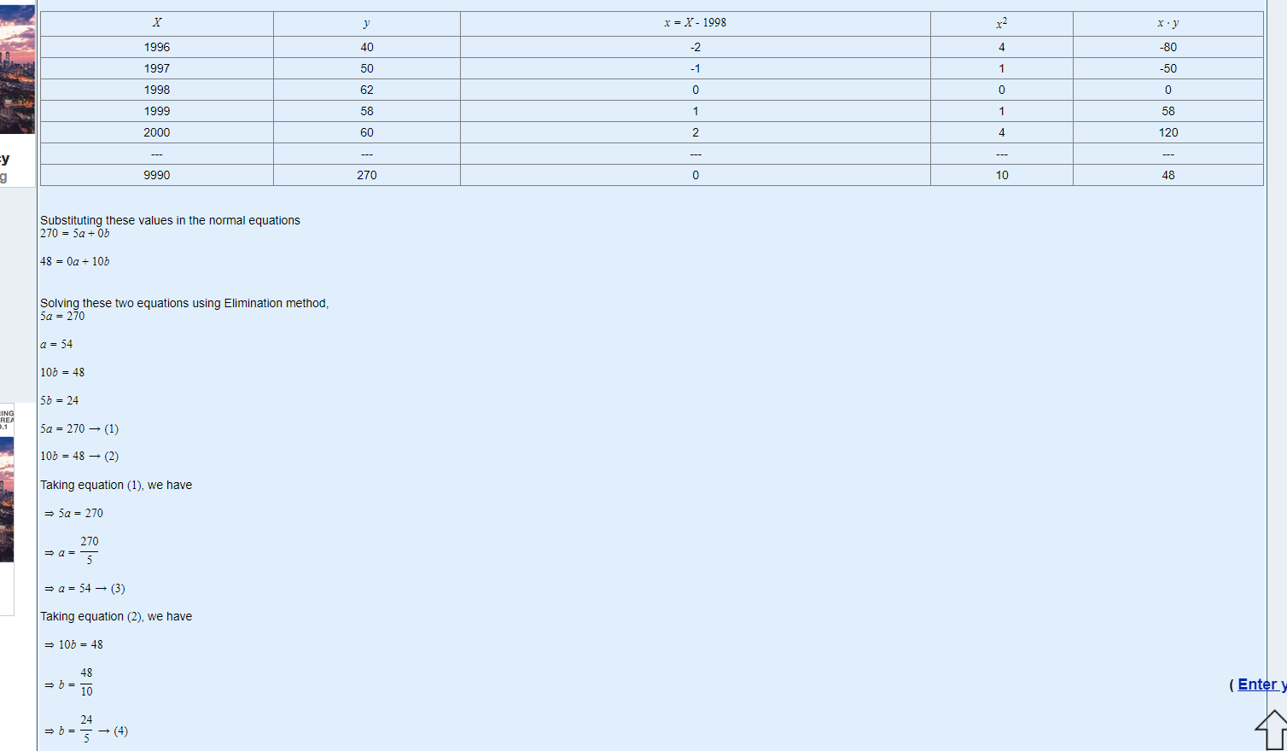

Slide 6
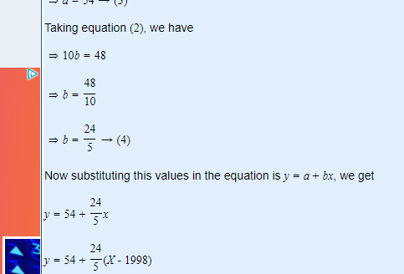

Slide 7
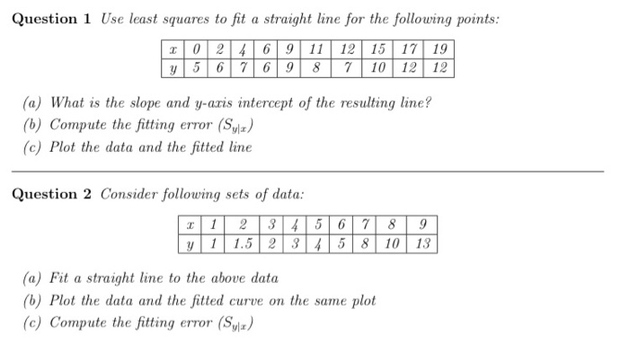

Slide 8
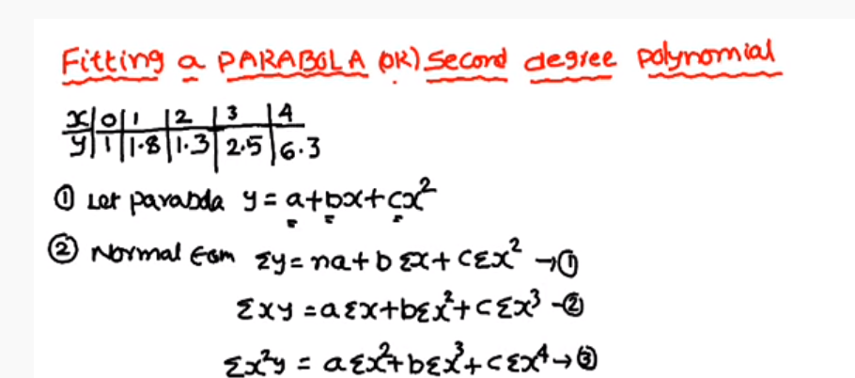

Slide 9
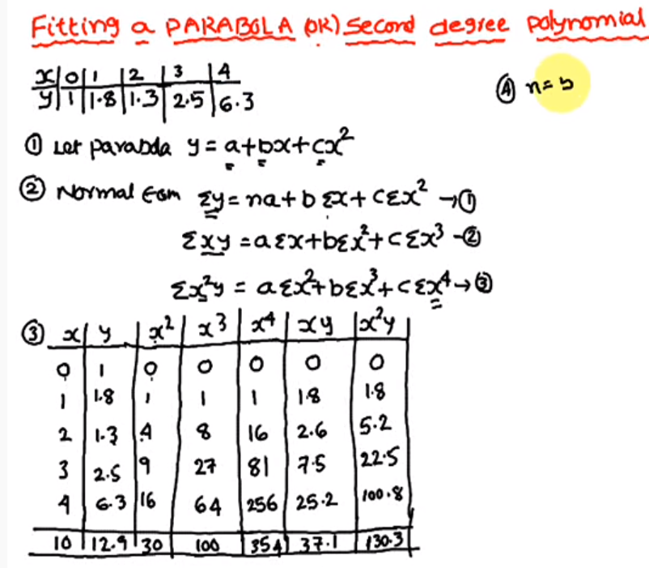

Slide 10
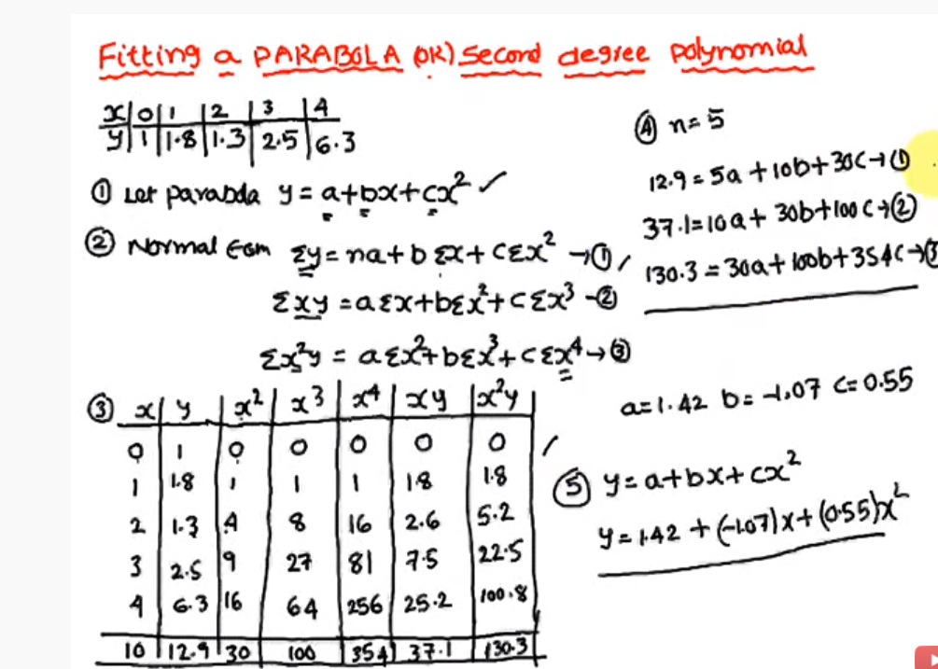

Slide 11
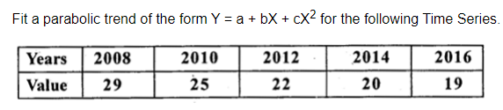
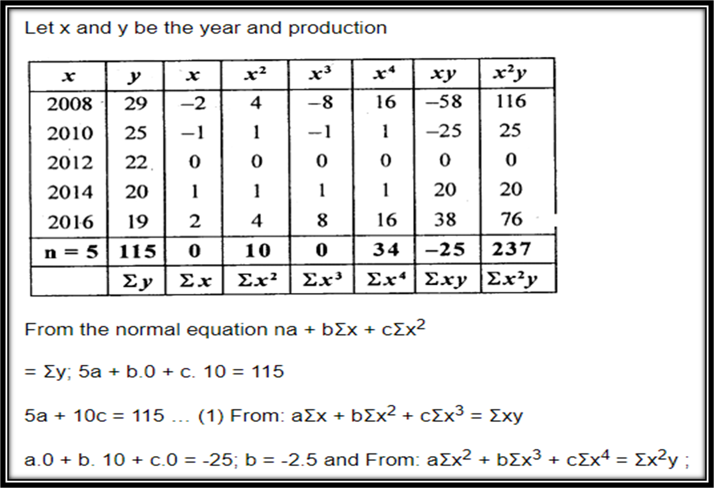

Slide 12
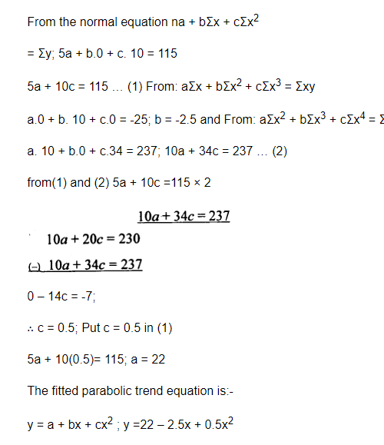

Slide 13
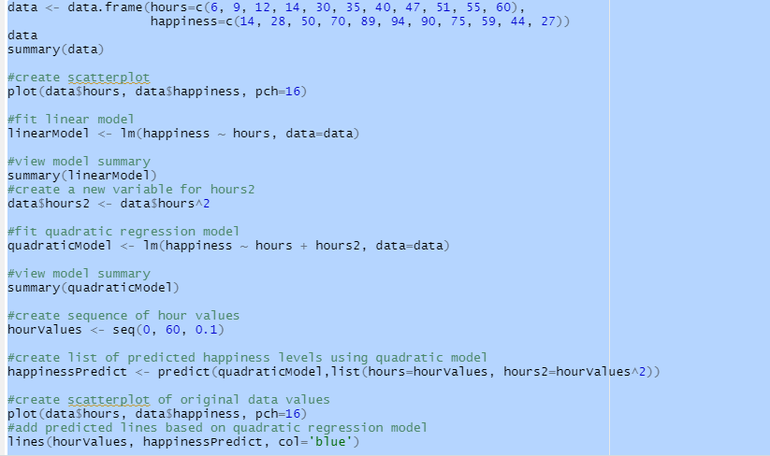

Slide 14
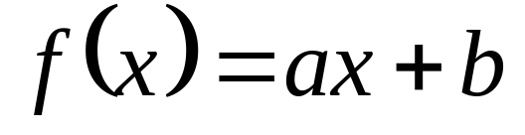
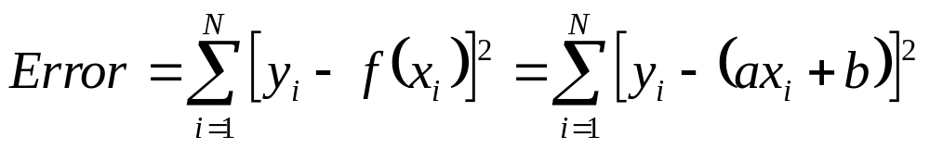
Minimum Energy Method : Least Squares Method
If our fit is a straight line

Slide 15
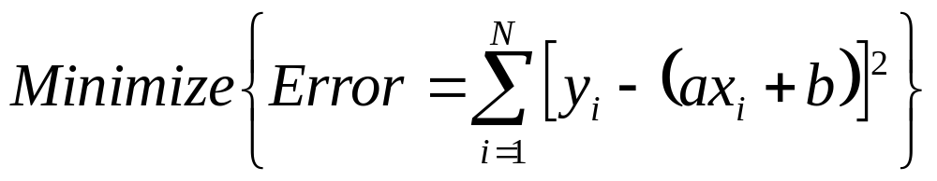
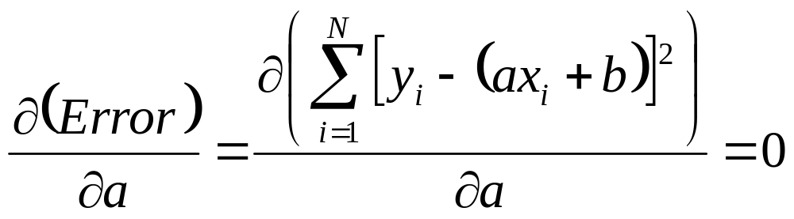
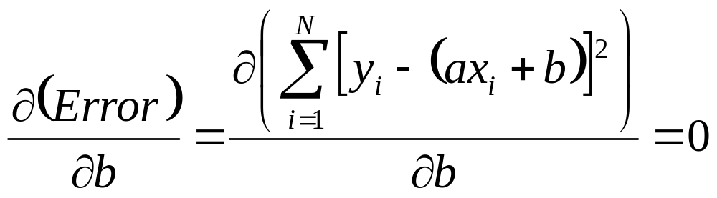
The ‘best’ line has minimum error between line and data points
This is called the least squares approach, since square of the error is minimized.
Take the derivative of the error with respect to a and b, set each to zero

Slide 16
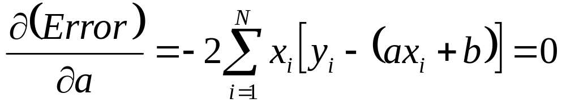
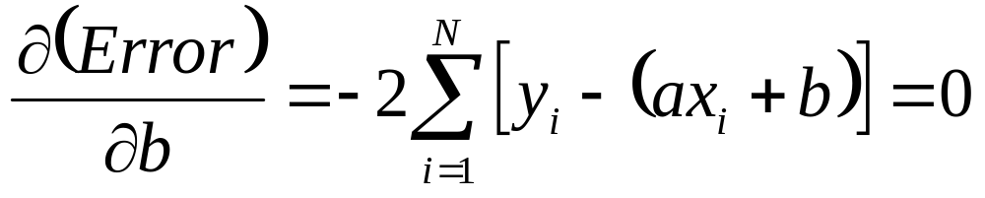
Solve for the a and b so that the previous two equations both = 0

Slide 17
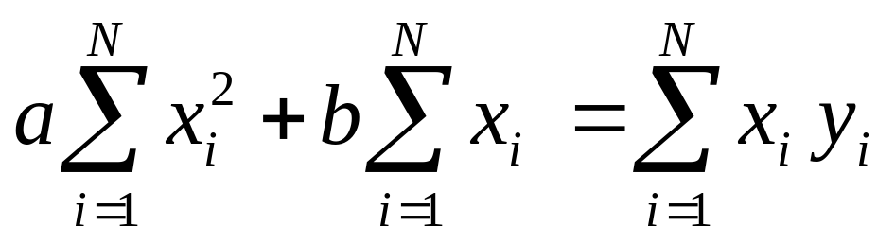
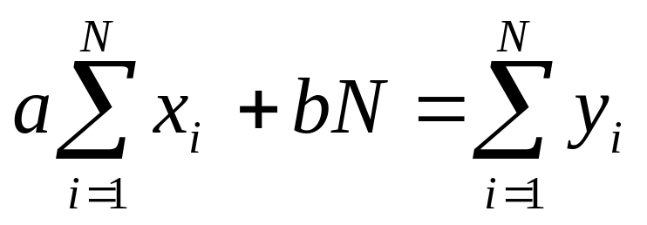
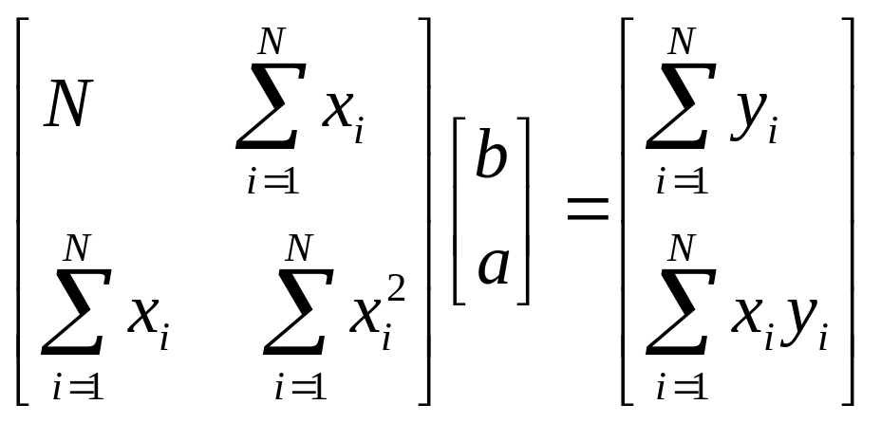
put these into matrix form

Slide 18
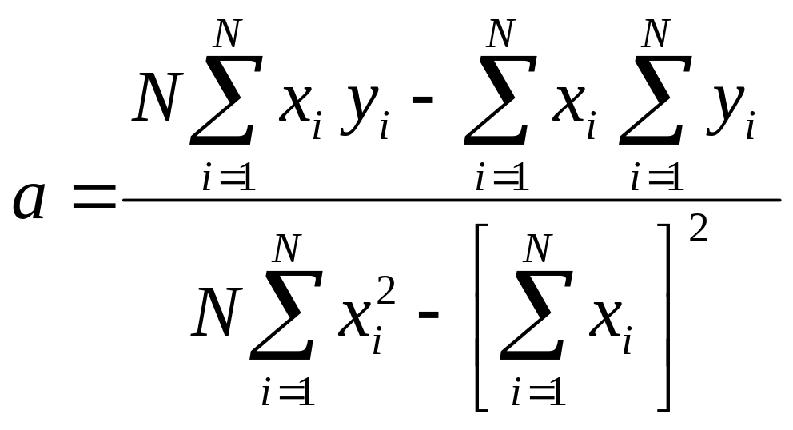
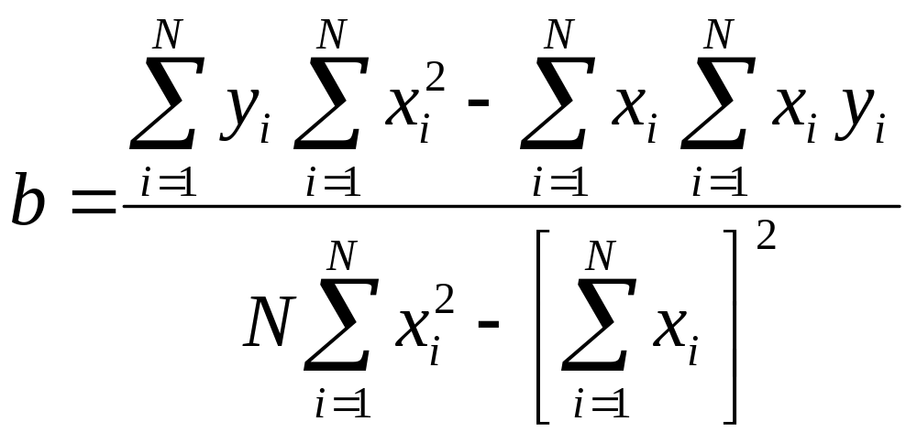

Slide 19
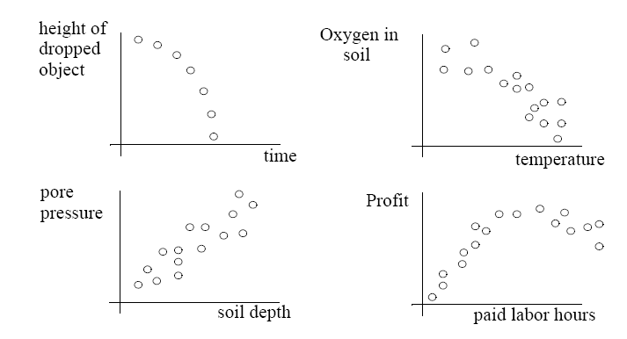
Is a straight line suitable for each of these cases ?

Slide 20
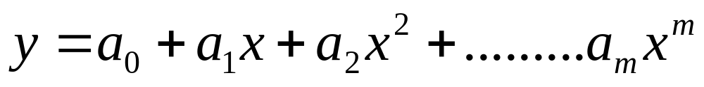
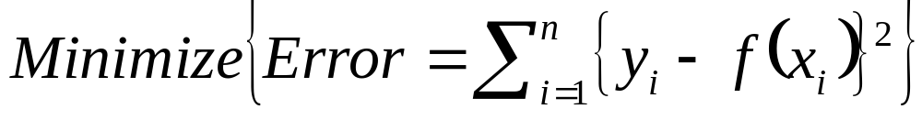
The Least-Squares m^{th} Degree Polynomials
When using an m^{th} degree polynomial
to approximate the given set of data, (x₁,y₁), (x₂,y₂)…… (x_{n},y_{n}), where n ≥ m, the best fitting curve has the least square error, i.e.,

Slide 21
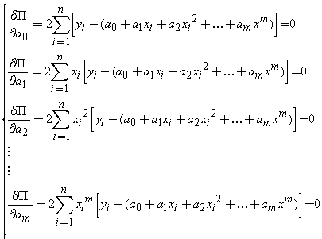
To obtain the least square error, the unknown coefficients a₀, a₁, …. and a_{m} must yield zero first derivatives.

Slide 22
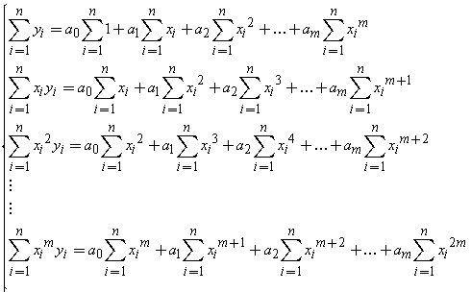
Expanding the previous equations, we have
The unknown coefficients can hence be obtained by solving the above linear equations.

Slide 23
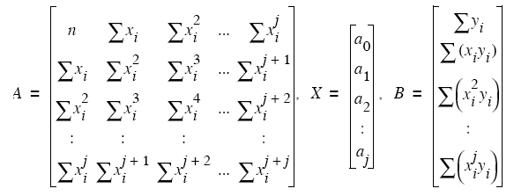

No matter what the order j, we always get equations LINEAR with respect to the coefficients.
This means we can use the following solution method

Slide 24
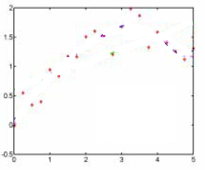
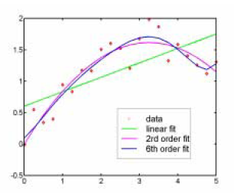
Selection of Order of Fit
2nd and 6th order look similar, but 6th has a ‘squiggle to it.
Is it Required or not?

Slide 25
Under Fit or Over Fit: Picking An appropriate Order
Underfit - If the order is too low to capture obvious trends in the data
Overfit - over-doing the requirement for the fit to ‘match’ the data trend (order too high)
Polynomials become more ‘squiggly’ as their order increases.
A ‘squiggly’ appearance comes from inflections in function
General rule: pick a polynomial form at least several orders lower than the number of data points.
Start with linear and add extra order until trends are matched.

Slide 26
Linear Regression Analysis
Linear curve fitting
Polynomial curve fitting
Power Law curve fitting: y=ax^{b}
ln(y) = ln(a)+bln(x)
Exponential curve fitting: y=ae^{bx}
ln(y)=ln(a)+bx

Slide 27
Goodness of fit and the correlation coefficient
A measure of how good the regression line as a representation of the data.
It is possible to fit two lines to data by
(a) treating x as the independent variable : y=ax+b, y as the dependent variable or by
(b) treating y as the independent variable and x as the dependent variable.
This is described by a relation of the form x= a'y +b'.
The procedure followed earlier can be followed again to find best values of a’ and b’.

Slide 28
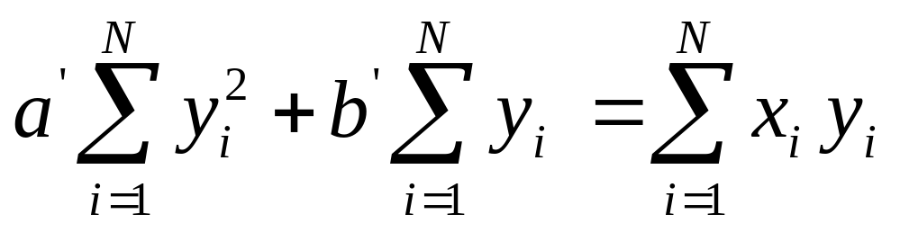
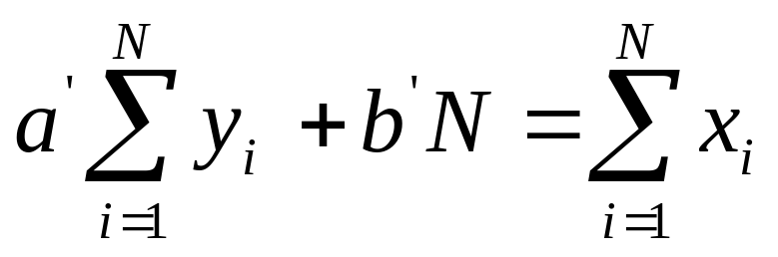
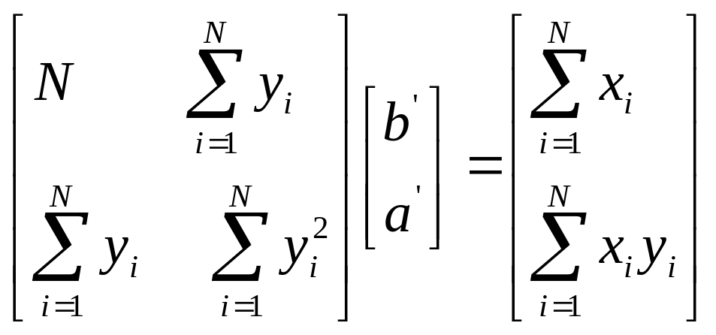
put these into matrix form

Slide 29
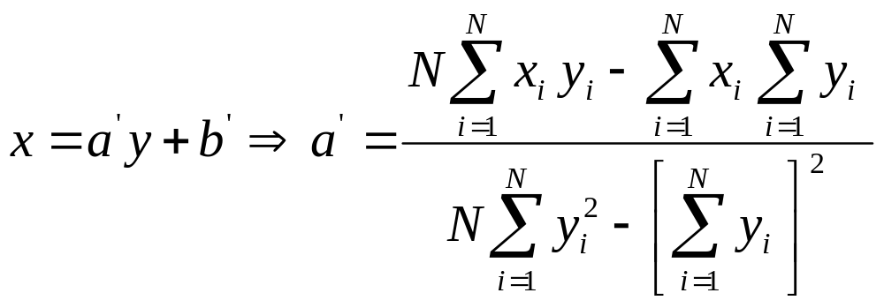
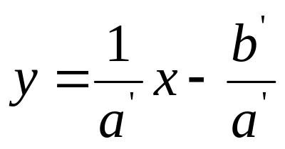

Recast the second fit line as:
is the slope of this second line, which not same as the first line

Slide 30
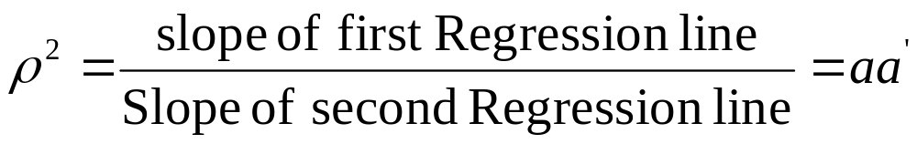
The ratio of the slopes of the two lines is a measure of how good the form of the fit is to the data.
In view of this the correlation coefficient ρ defined through the relation

Slide 31
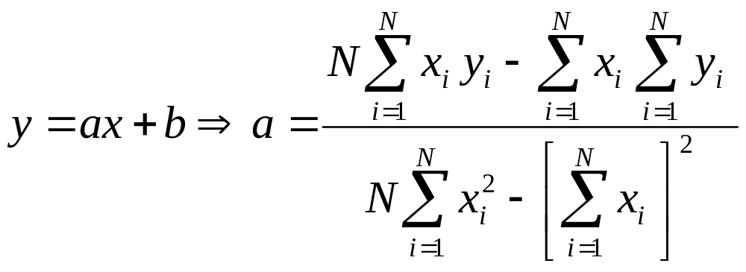

Slide 32
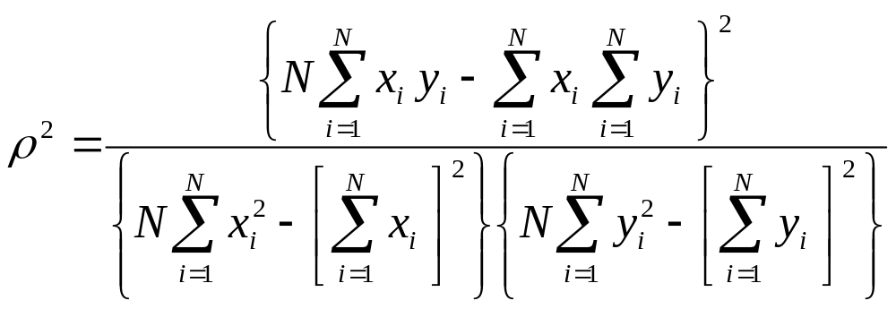
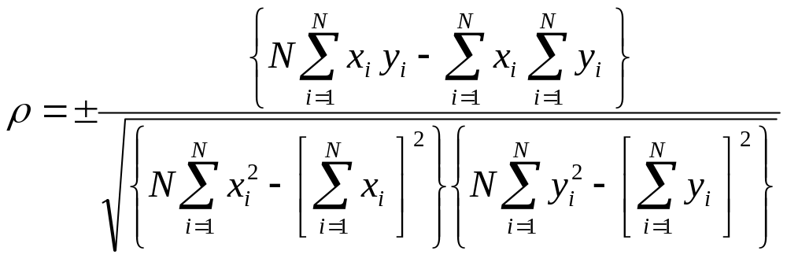

Slide 33
Correlation Coefficient
The sign of the correlation coefficient is determined by the sign of the covariance.
If the regression line has a negative slope the correlation coefficient is negative
while it is positive if the regression line has a positive slope.
The correlation is said to be perfect if ρ = ± 1.
The correlation is poor if ρ ≈ 0.
Absolute value of the correlation coefficient should be greater than 0.5 to indicate that y and x are related!
In the case of a non-linear fit a quantity known as the index of correlation is defined to determine the goodness of the fit.
The fit is termed good if the variance of the deviates is much less than the variance of the y’s.
It is required that the index of correlation defined below to be close to ±1 for the fit to be considered good.

Slide 34
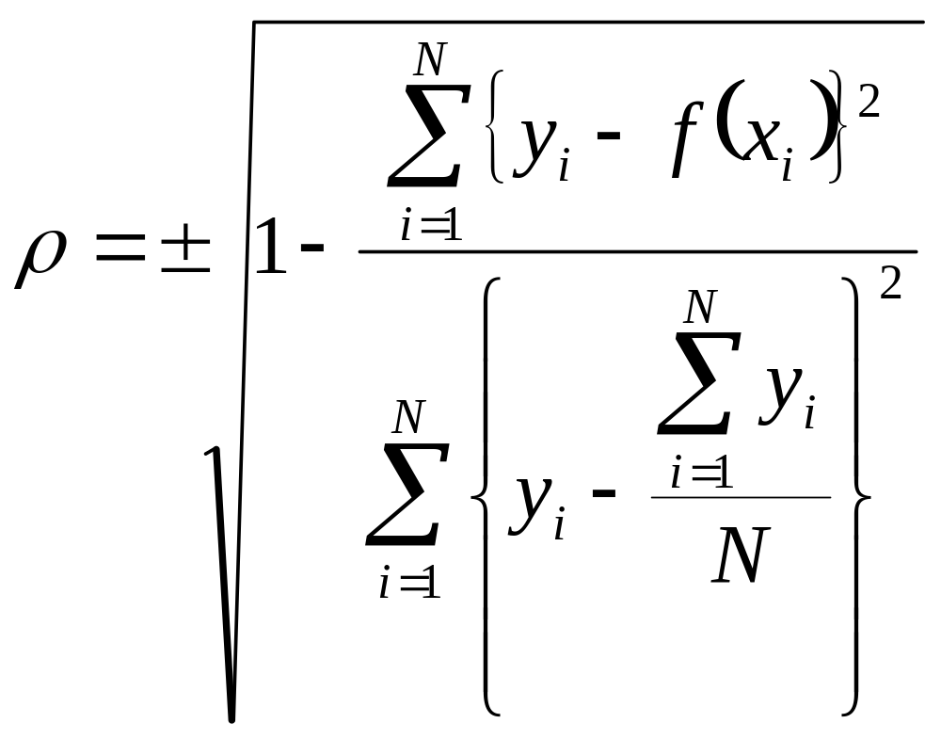

Slide 35
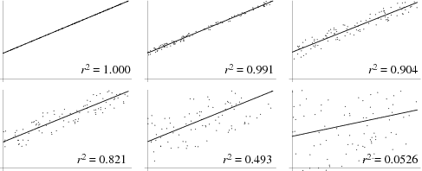
ρ²=1.000
ρ²=0.991
ρ²=0.904
ρ²=0.821
ρ²=0.493
ρ²=0.0526

Slide 36
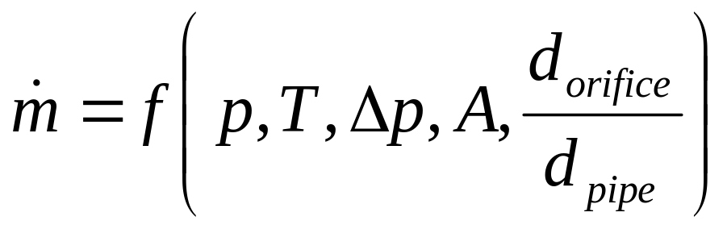
Multi-Variable Regression Analysis
Cases considered so far, involved one independent variable and one dependent variable.
Sometimes the dependent variable may be a function of more than one variable.
For example, the relation of the form
is a common type of relationship for flow through an Orifice or Venturi.
mass flow rate is a dependent variable and others are independent variables.

Slide 37
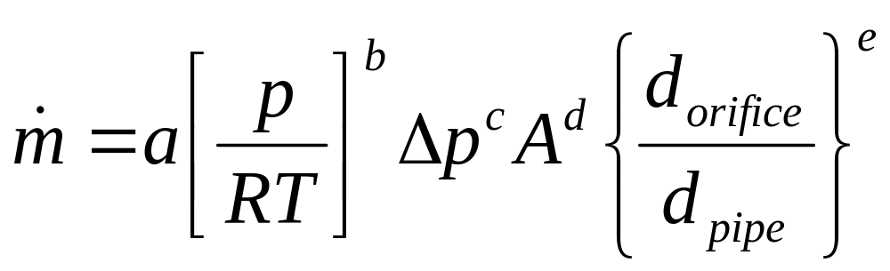
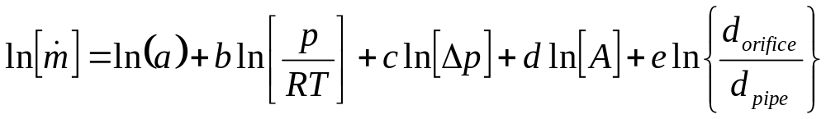
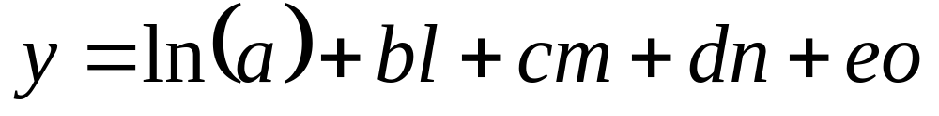
Set up a mathematical model as:
Taking logarithm both sides
Simply:
where y is the dependent variable, l, m, n, o and p are independent variables and a, b, c, d, e are the fit parameters.

Slide 38
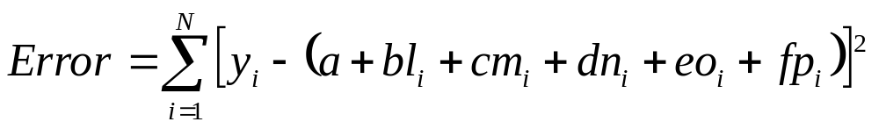
The least square method may be used to determine the fit parameters.
Let the data be available for set of N values of y, l, m, n, o, p values.
The quantity to be minimized is given by
What is the permissible value of N ?

Slide 39


The normal linear equations are obtained by the usual process of setting the first partial derivatives with respect to the fit parameters to zero.

Slide 40


These equations are solved simultaneously to get the six fit parameters.
We may also calculate the index of correlation as an indicator of the quality of the fit.
This calculation is left to you!

